Slide 1

Global Jam Program
Overview

Slide 2
Global Jam Program
The Global Jam Program is built to support sites in three (3) phases
Phase 1 data collection and site analysis
Phase 2 physical site audit
Phase 3 Adhoc Network projects
The program is built to support sites and provide a period of program management. The Jam team will support the site with available RME resources and RME support team assistance such as (Amazon Robotics, MHE SME, WHS SME, Amazon Engineering etc..)

Slide 3
Global Jam Program Phase 1
Site analysis report is built using the following data collection, driven by the following metrics below
Jam Faults
OEE Availability
SEV/HIE Event
Throughput (Site Volume)
Safety Events Related to Jams
JAM PCA’s
Additional: Network Jam Initiatives (CI & Best Practices)

Slide 4
Global Jam Program Phase 1
Building the Site Analysis Report consists of five (5) key metrics to assess the overall health and jam-related performance of each site:
Faulted (Occurrences): Quantifies the total jam occurrences for the equipment in a faulted or jammed state
OEE Availability (%): Measures the overall equipment effectiveness and availability at the site
Throughput of Site (Units): Assesses the overall production volume and capacity of the site
SEV/HIE Events (Count): Tracks the number of SEV/HIE (Severe / High Incident Events) events occurring at the site, which indicate major equipment or process failures
Safety (Risk): Evaluates the safety risk profile of the site based on incident history

Slide 5
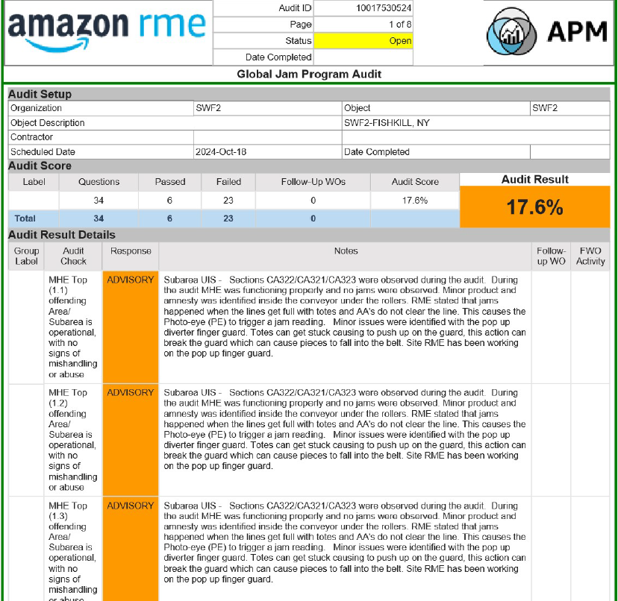
Global Jam Program Phase 2
Consist of a physical site audit based on the top jam problem areas identified on the site analysis report
Audit Pre-Assessment is completed with physical audit date and site POC information - Asana
Physical Audit is completed with a grading system in APM
Audit Pre-Assessment
Physical Audit Assessment

Slide 6
Global Jam Program Phase 2 (PM Support)
After the audit is complete, the GJP team can provide PM support for sites that need the additional assistance
At the end of the project support period a closing meeting report will be established
Chime Room is Created
Biweekly Meeting is Scheduled
Trend Analysis report
Network Projects are reviewed and Discussed
Closing Report

Slide 7
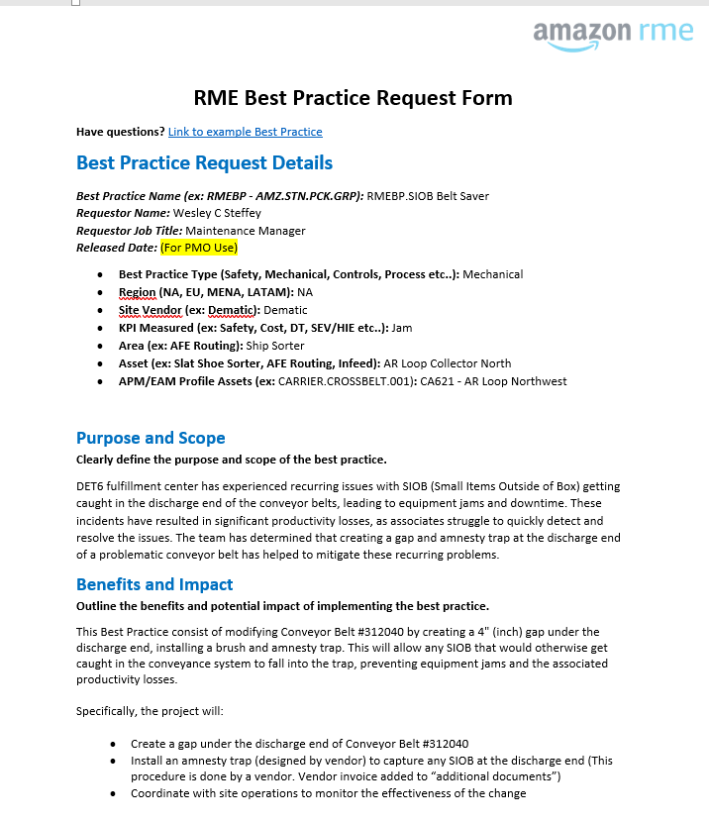
Global Jam Program Phase 3
Consist of identifying Network projects mostly driven through Best Practices submitted by sites that are focused on JAM’s
Identify potential Jam Best Practices that needs to be piloted before converting them to a CI or PCA project
Pilot site Jam Best Practices Submission
Identify sites that can benefit from the Best Practice and use them as a Pilot source
Track the pilot and establish if final results can be upgraded to a PCA/CI

